Slide 1

Human Face Recognition Attendance System
BY
SURYANSH GUPTA

Slide 2
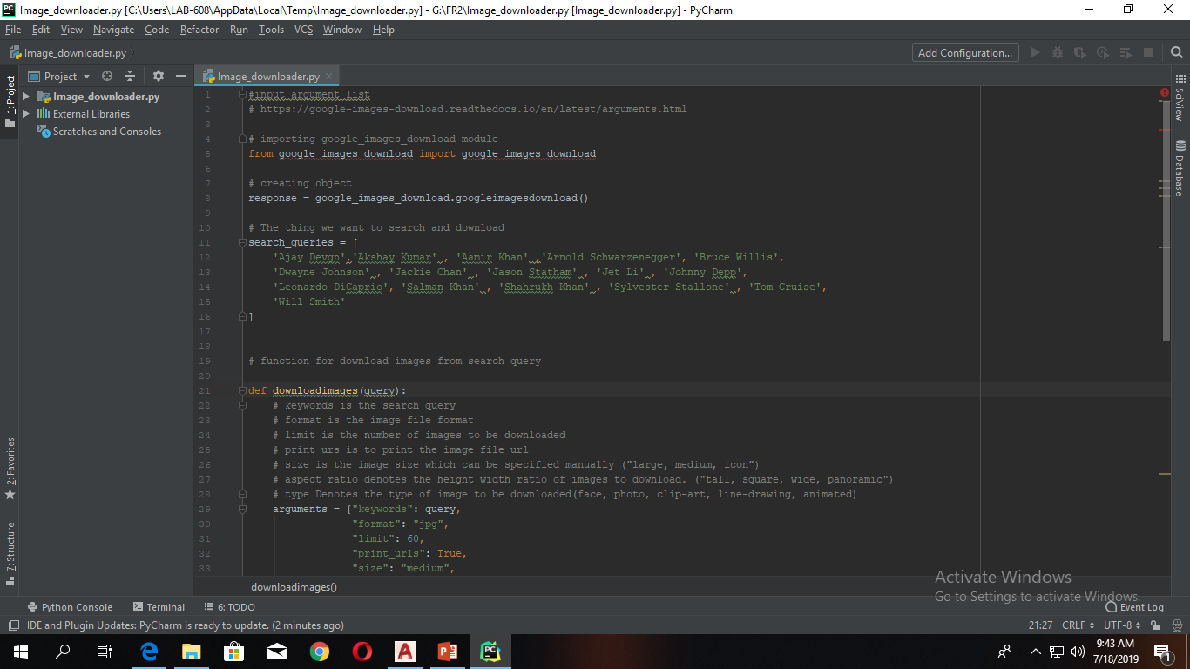
Automatic Image Downloader script
In the project we need to download so many images for train our algorithm. To download more than 100 images its not easy. So solve this problem we build a python script. This script will follow the search query to search and download the images from google search engine.

Slide 3
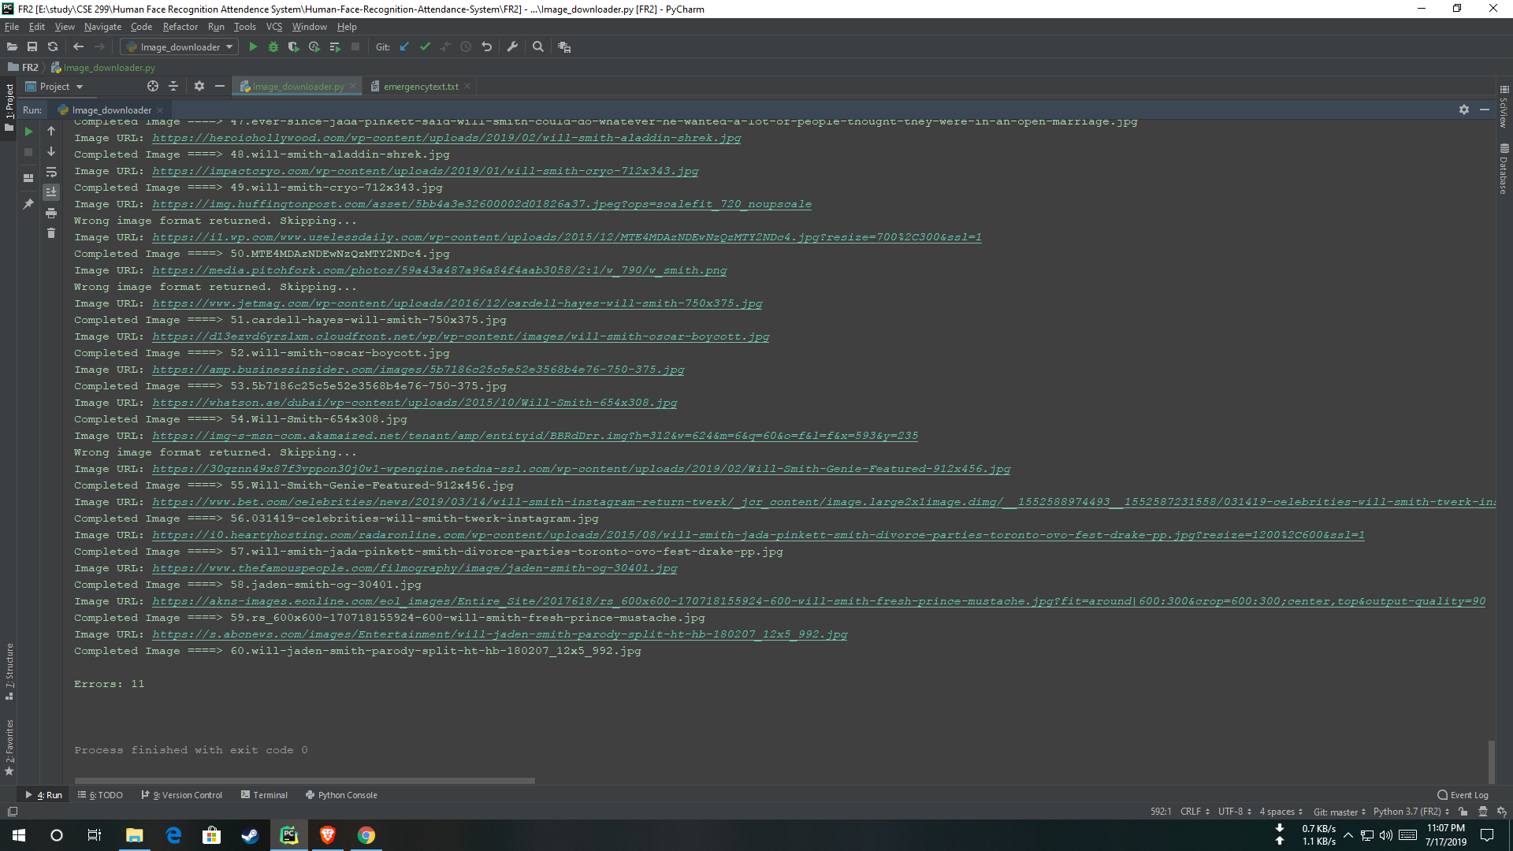
Image downloader result

Slide 4
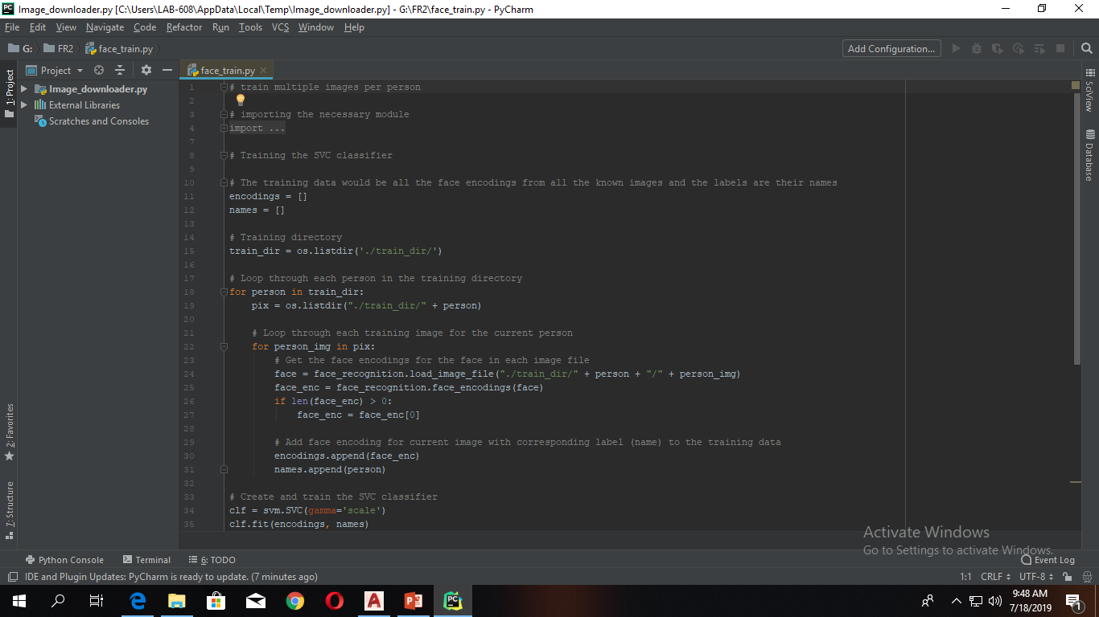
Image trainer

Slide 5
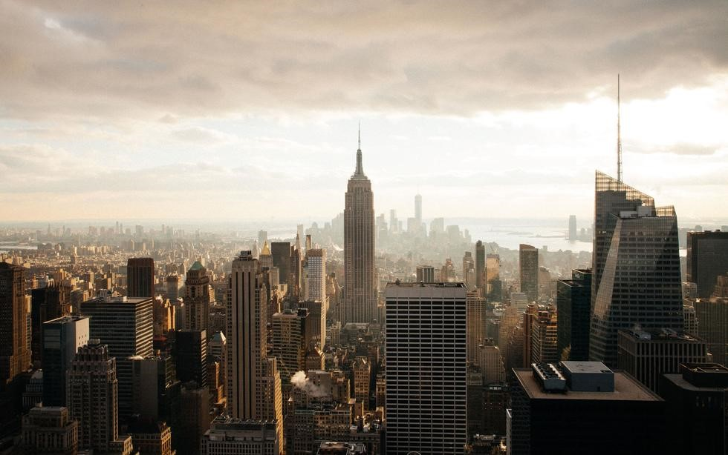






Milestone & TIME FRAME
100%
0%
100%
100%
100%
E
Installing
Products
Image Processing
& apply
Write System
code
Use camera for Image
Processing
Assembling Everything

